Slide 1
Main Things to take in mind
Firstly Mark Support(Demand) and Resistance(Supply).
Then mark Order Blocks.
Rules
3 Trades per Day – 3 STRIKE RULE ( if 1st and 2nd trades goes to loss – stop Trading ) Trade on Next day.
Specific Hours Like in (London and New York Session ) Find your daily hour trading time and sessions. | Volatility
3% Risk through the day. | Risk Management.
Direction ( trading plan is based on direction, if upwared try to enter long on pullbacks(correction) | Liquidity and MS(Market Structure) is making me understand the direction. (find bos) and mark the premium OB on big time frame like 1 hr or 4 hr.
Confirmation.
Shifting our SL to the entry and in profit zone once it goes to the profit zone
Don’t trade without analysis and news event = Only trade with analysis and news events
DXY – Dollar Index | SPX (S & P 500 Indes) US Stock Market | BTC Domincnace – When it increased = alt coin bleeds. | Session – keep in eye.
FOMO – Fear of missing out = Don’t FOMO – this is not my last trade mis ho gaya to ho gaya
Grid Trading once good fund is available

Slide 2
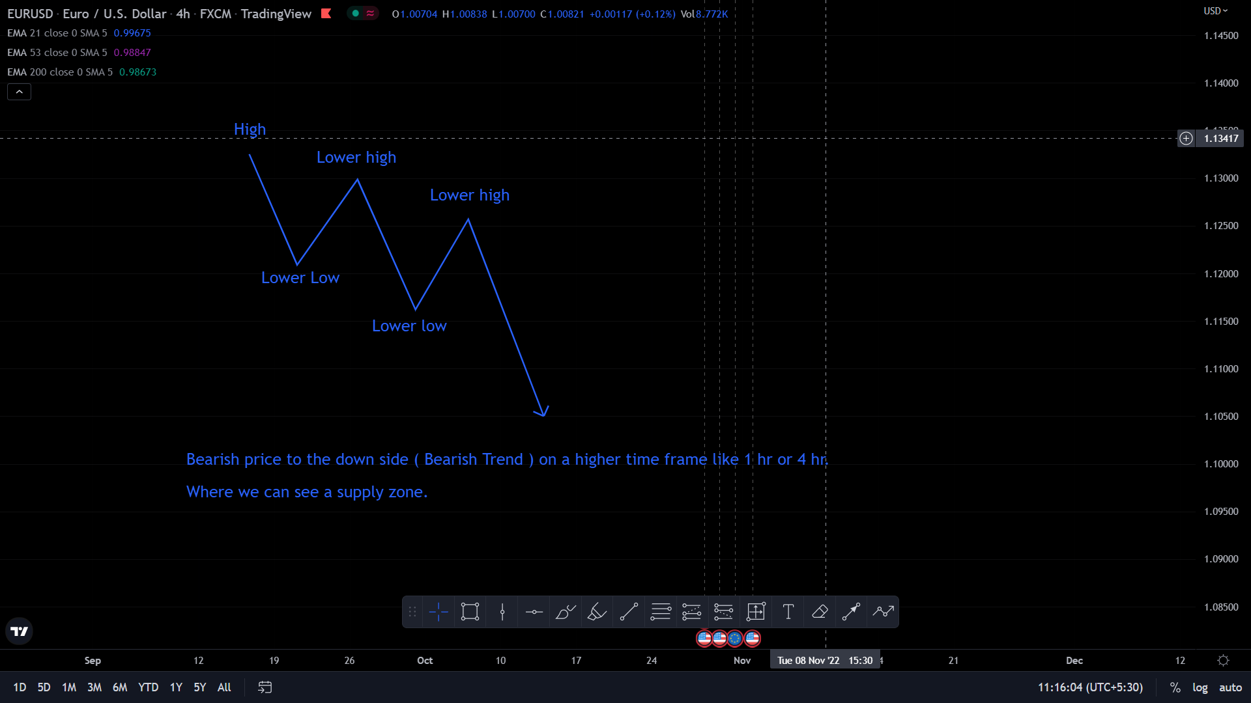
What is Supply
Supply zone this is the area of consolidation that comes before an impulse move towards the down side, where there is a bearish price action.
Supply zone can also act as resistance when price action pushes up into them from the down side.

Slide 3
The approaching structure of down trend is where the price broke the previous low and there is a supply created and the price came back on that supply area and respected him.
Equal Lows where liquidity resides below it.
What is a Demand Zone ?
Demand zone is the area of consolidation that comes before an impulse move towards the upside, where there is a bullish price action.
How to spot demand zone in a reversal structure
A demand is created when there’s a bullish momentum that breaks the previous high.
When the market change it’s character from bearish to bullish there’s a possibility that it will reverse.

Slide 4
How to find liquidity and different types of liquidity
What is Liquidity
The markets need to generate liquidity in order to move up or down. If Liquidity isn’t already there, then it will be created.
Retail basics are like support and resistance, double top, double bottom and trendlines.
Smart Money VS Retail Trading
Supply and Demand Support and Resistance
Unmitigated = stronger More test levels= Stronger
Retail stop loss Breakout Entries
Imbalace Break and Retest
Financial Institution candle.

Slide 5
The Trading Edge that you must know
Strategy – Basic Data: Entry, SL, TP.
- Multi-Timeframe Aanalysis
- Backtesting
- Reduce your stress.
Risk Management
- PLAN YOUR TRADE AND TRADE YOUR PLAN
- EXIT AT RISKY ZONE
- CURRENT MOMENTUM DOESN’T SUPPORT YOUR BIAS.

Slide 6
Goal : To become a consistent profitable funded trader
Backtest
Avoid doing revenge trades
Risk .50% per trade
Stop trading if loss is -1% per day
If the SL is above 30 pips don’t take the trade.
30=lot : 0.17
20=lot : 0.25
10=lot : 0.50
https://www.myfxbook.com/forex-calculators/position-size
Make sure to have a positive account for the repeat
Next page trading info and previous things

Slide 7
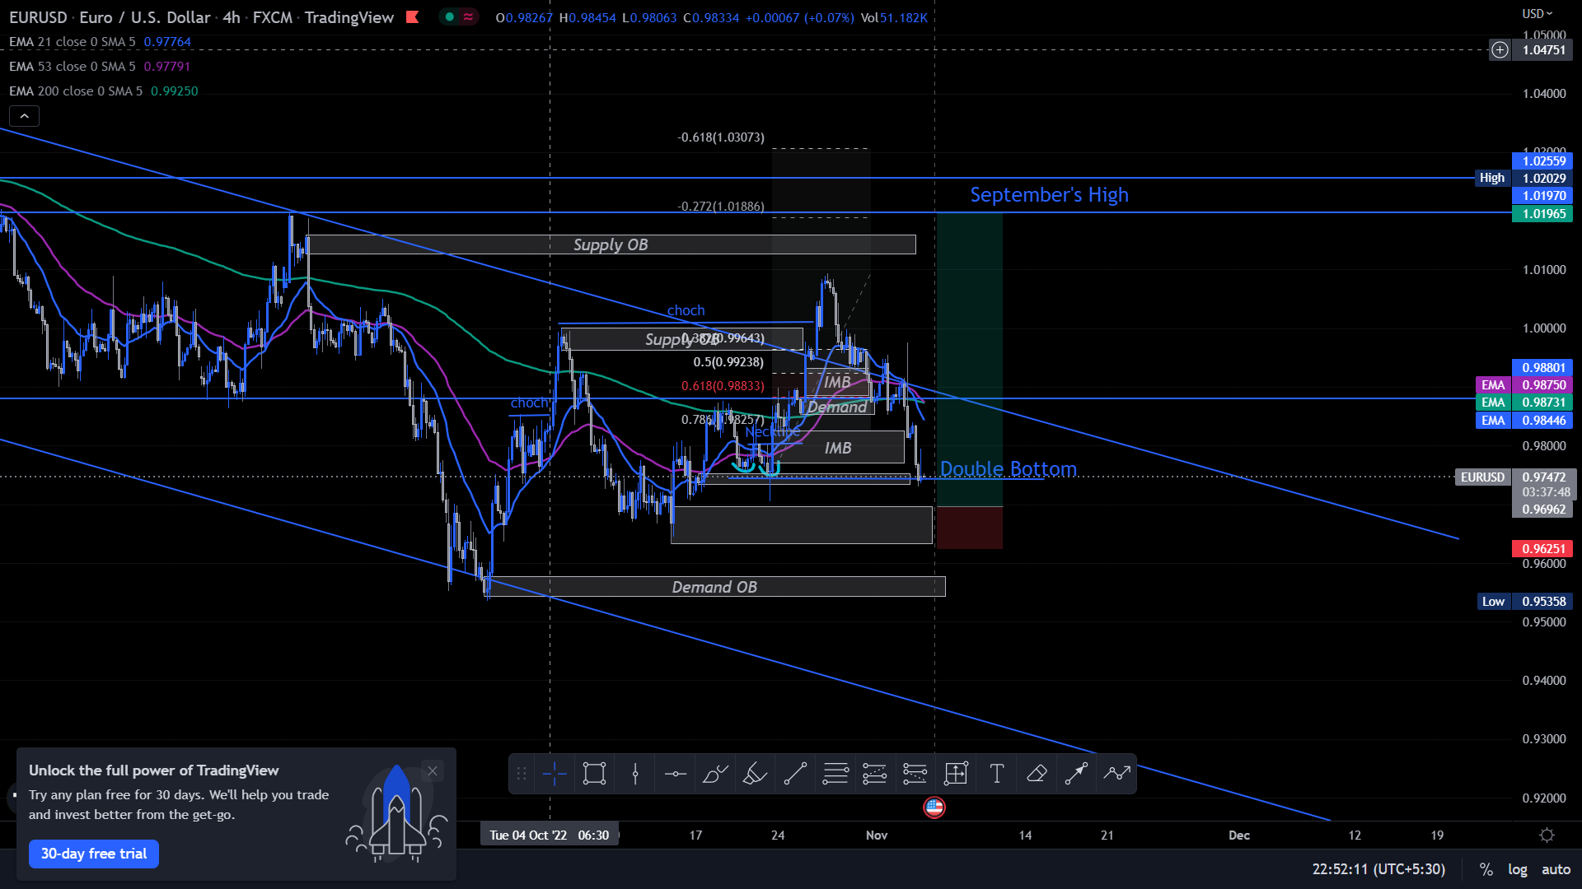
1st Trade : EURO USD 04NOV2022 – Challenge phase
Trading view link
Reason for taking the trade:
- Market have crossed the double bottom after a breakout.
- Market have touched the demand zone.
Moved SL to BE and
Took partials $17.09

Slide 8
How to trade the 1 minute timeframe
First we need to start with higher timeframe like 4 hours to see the market trend and to see how the price is going from this area.
Mark High, Low , Lower high, lower low ( in down treand ) same in 4 hours. And mark OB’s and supply zone and demand zones. And finding a market touching supply zone and demand zone in 4 hour time frame then ->
So going down to the lower downframe.

Slide 9
Pay attention to trading times
When the London and European markets open, for example, volume intensifies as institutional traders move the forex markets. Then, once the New York session opens, forex trading volume increases again.
There is a lull between New York markets closing and the Sydney session opening. When trading volume reduces, spreads might widen, markets might be stagnant, and the fills you get might not be as precise.
Use stops and limits
Take care of the details

Slide 10
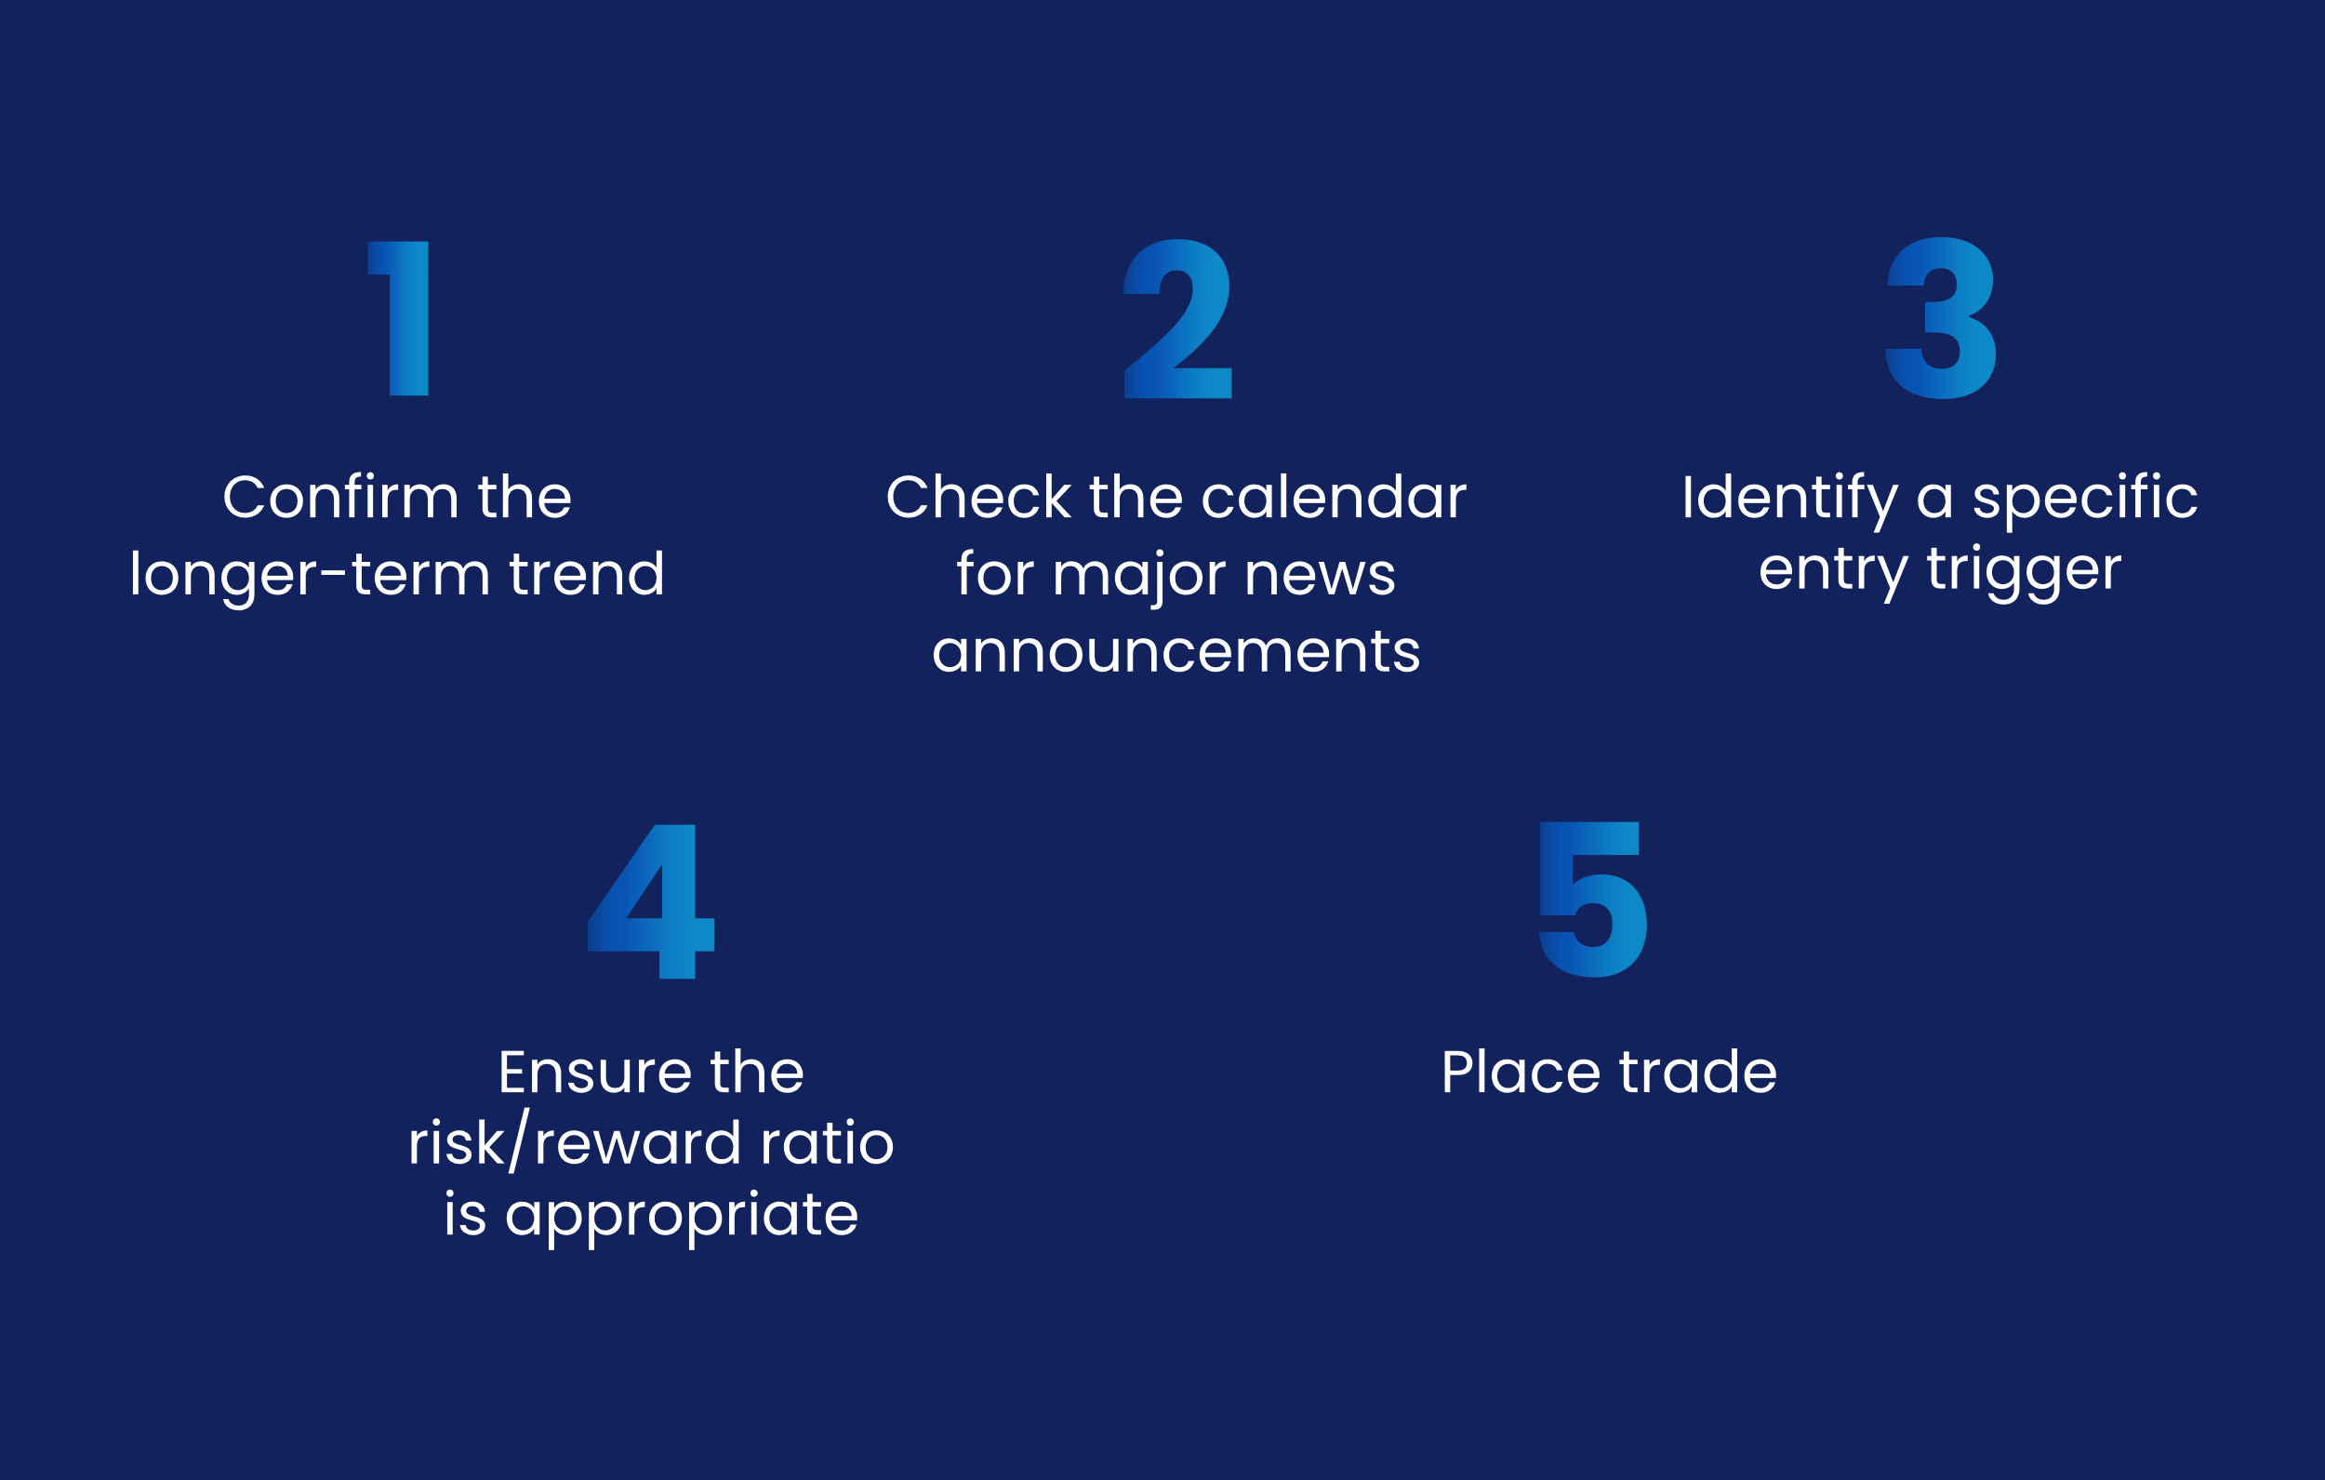
The final step when creating a successful forex trading plan is to add as much detail as possible. Lay out precisely which markets you’re going to trade and when. Decide how much capital to allocate to each position, as well as where to set stops and limits.
The final step when creating a successful forex trading plan is to add as much detail as possible. Lay out precisely which markets you’re going to trade and when. Decide how much capital to allocate to each position, as well as where to set stops and limits.

Slide 11
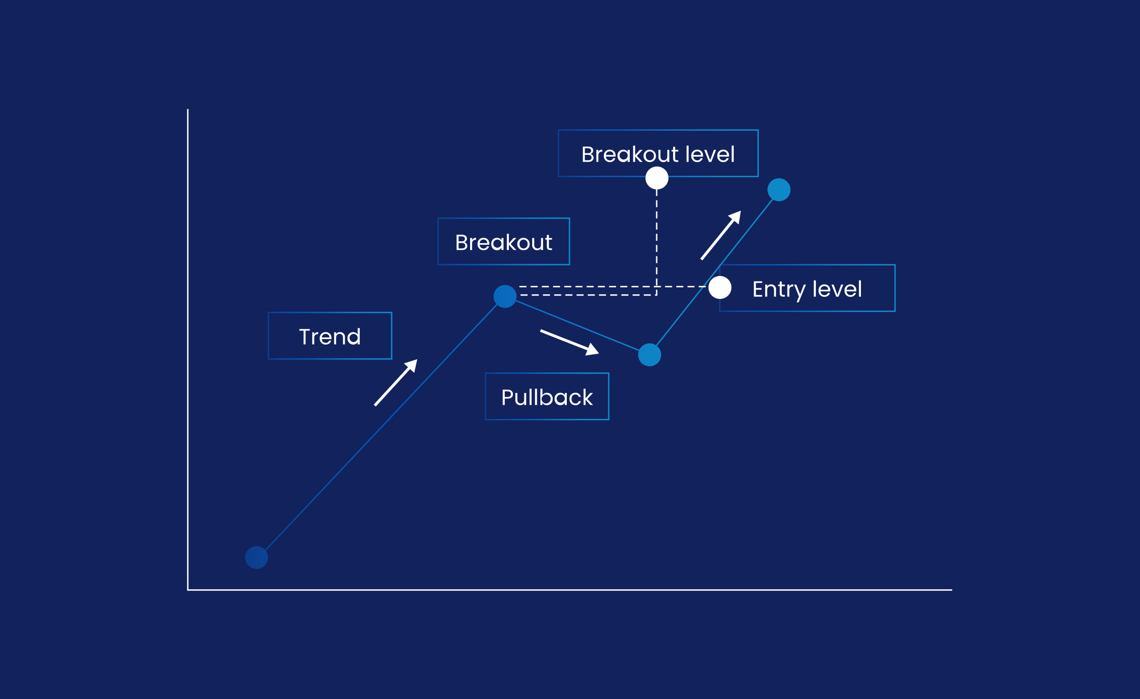
Finally, consider keeping a trading diary. This enables you to see precisely how your trading journey is progressing, so you can identify your strengths and weaknesses, eliminate mistakes, and build on successes.
Breakouts occur when a market breaks through one of these levels. When you see a breakout, it’s a sign that the original trend is reforming. This makes them a useful place to enter a trade, by opening a buy or sell position once the market moves beyond the support or resistance line.
Generally, the more times a support or resistance level is tested, the stronger the breakout that follows will be once it is broken.

Slide 12
